Slide 1

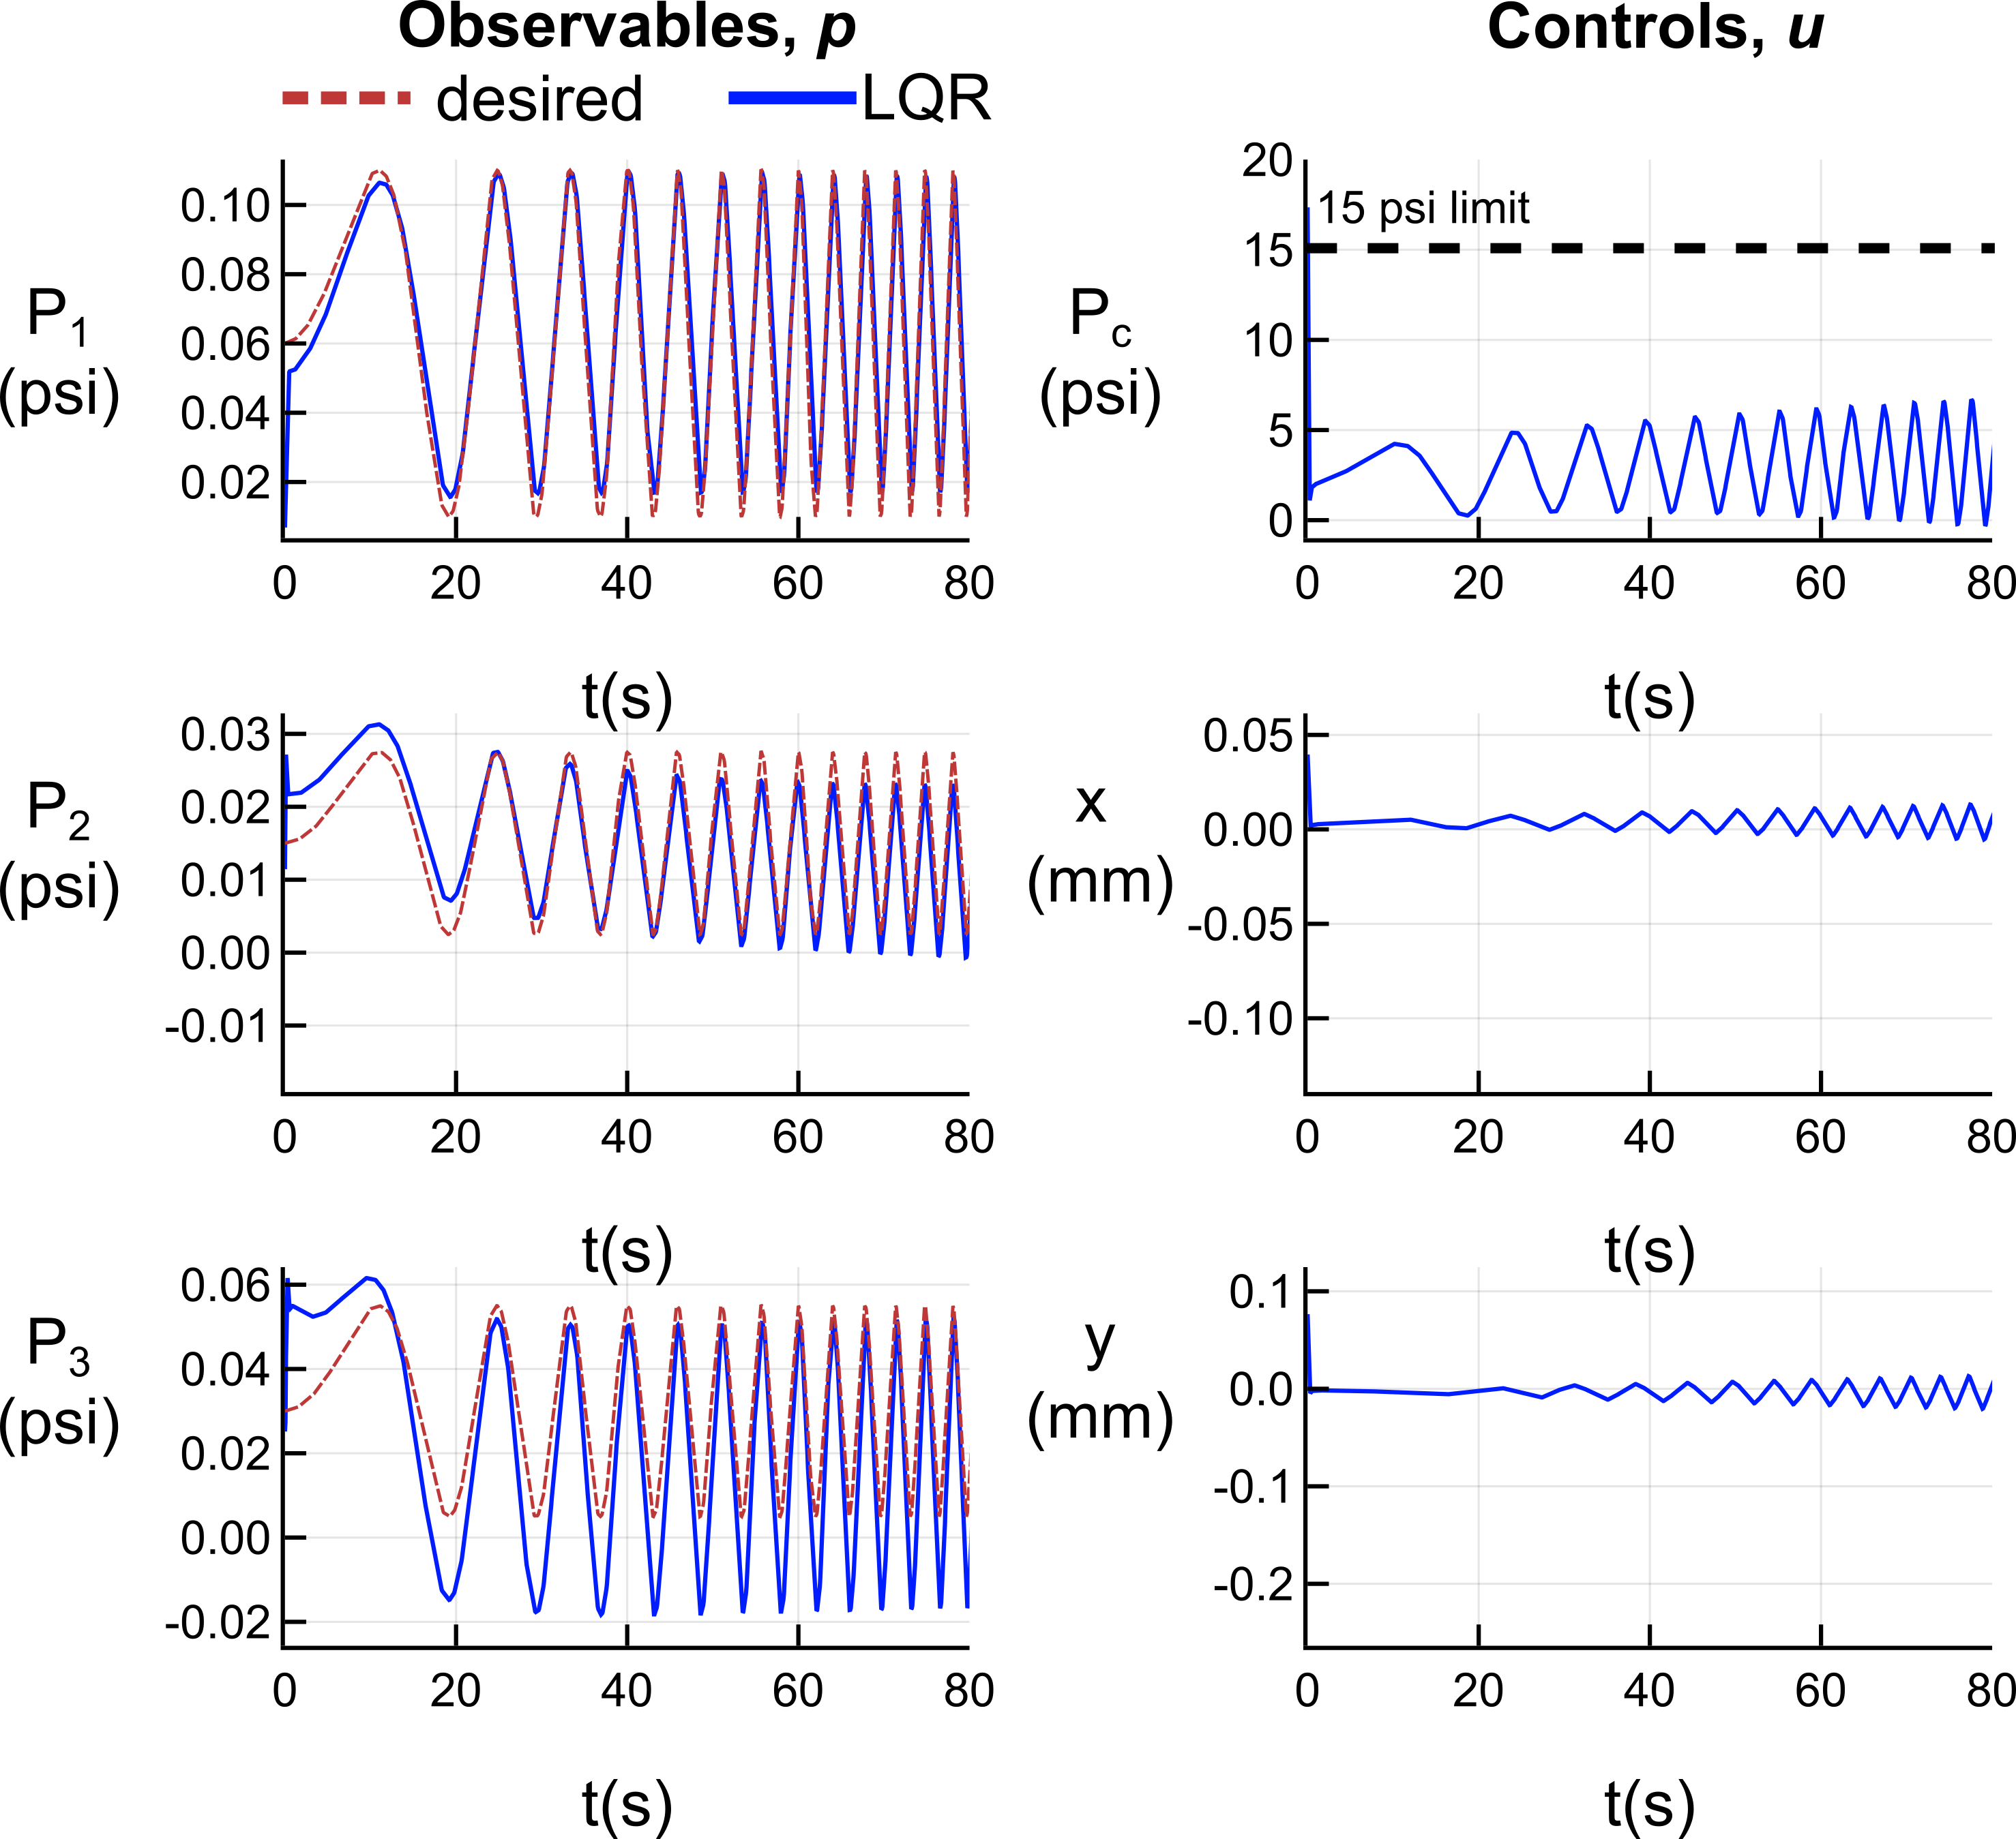
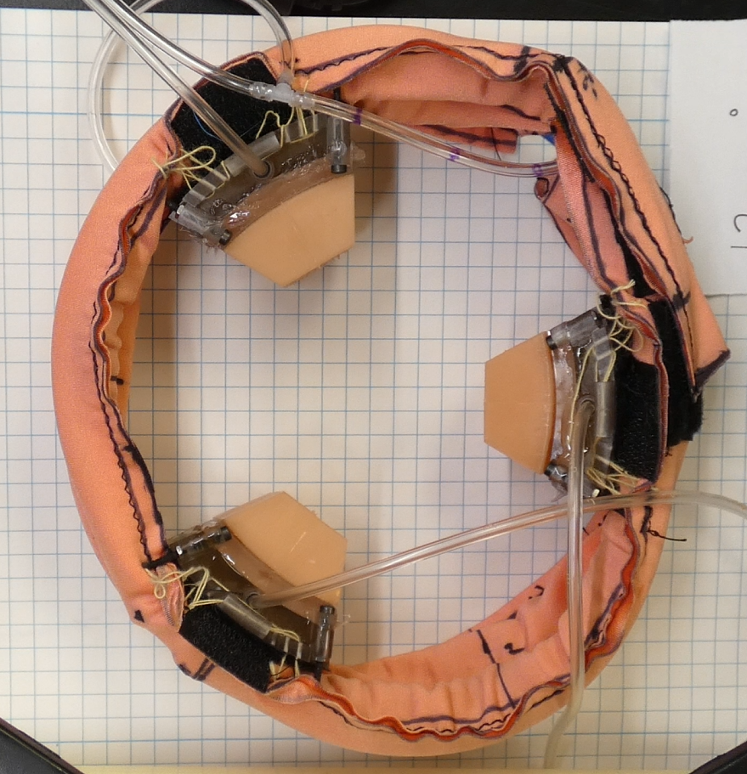
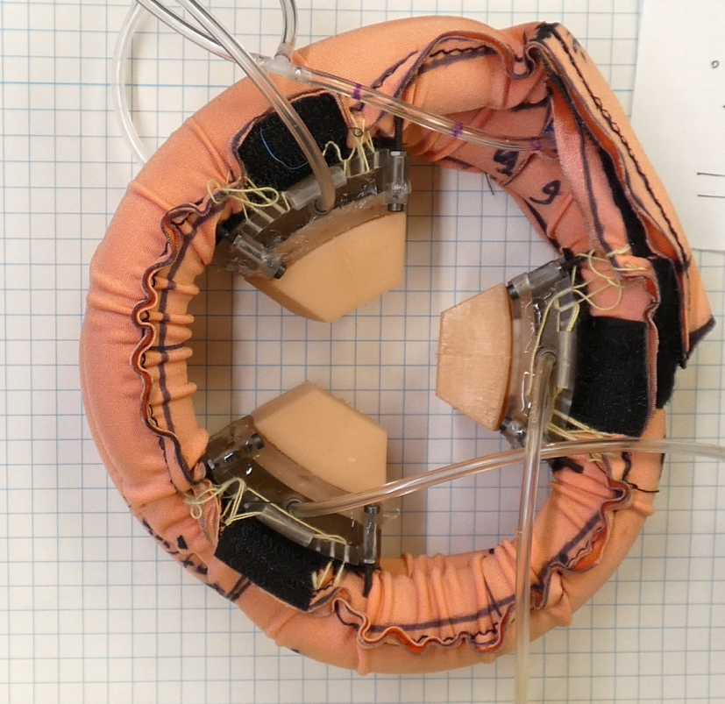
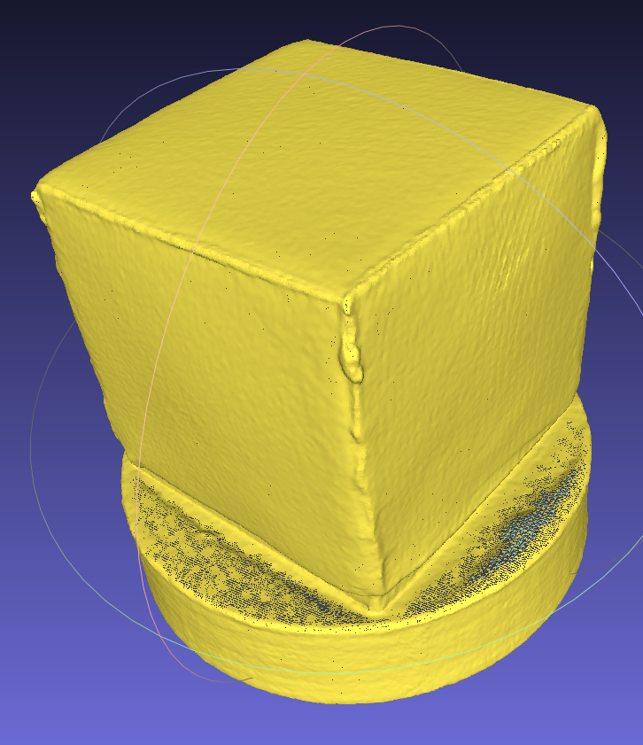
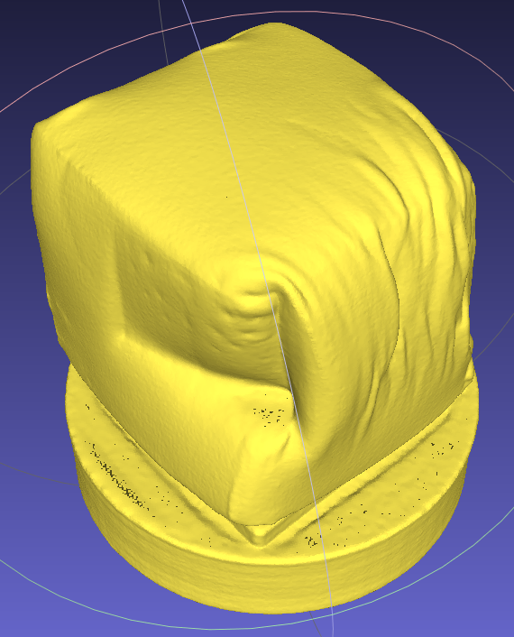
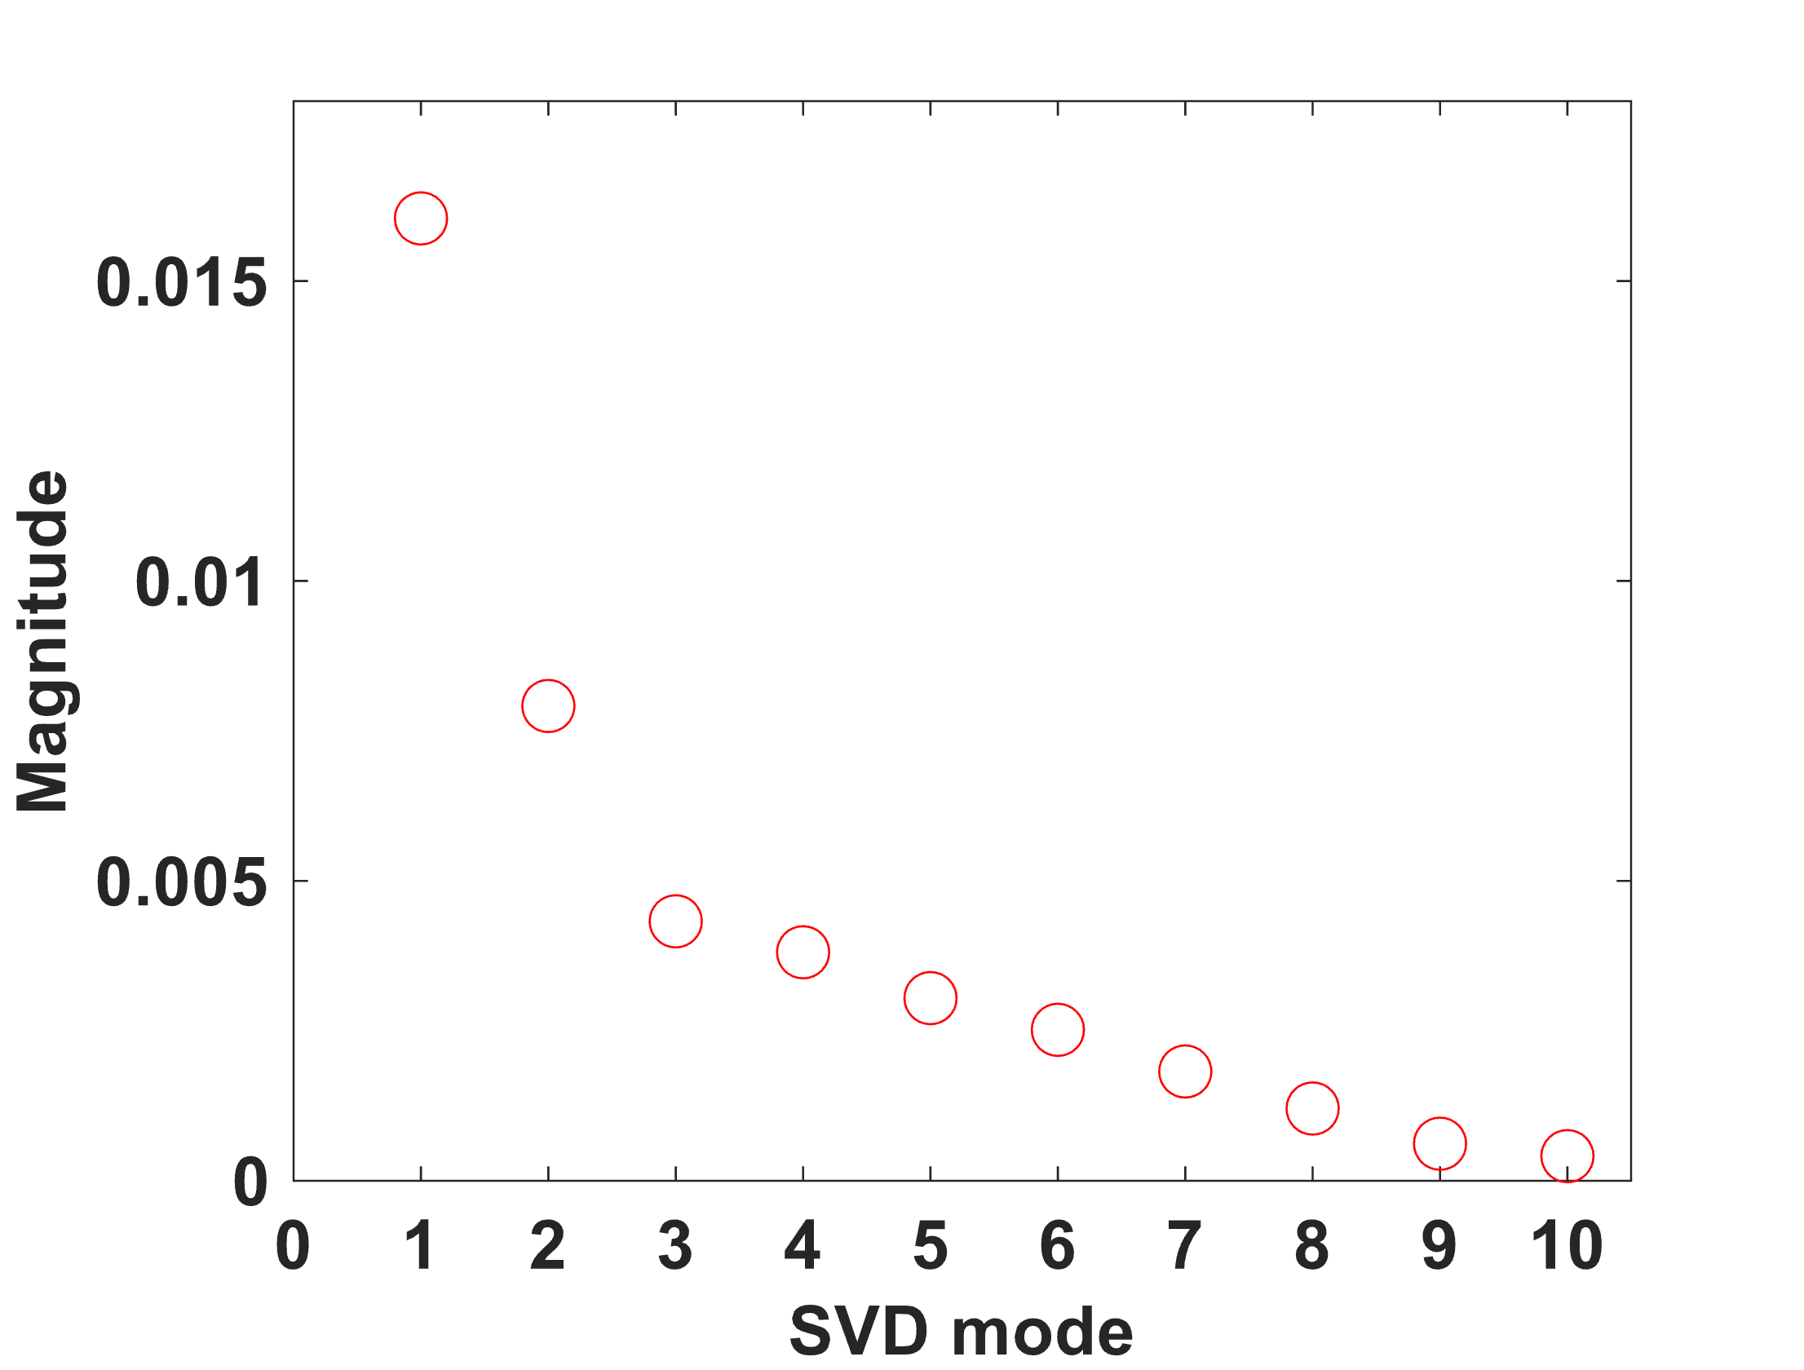
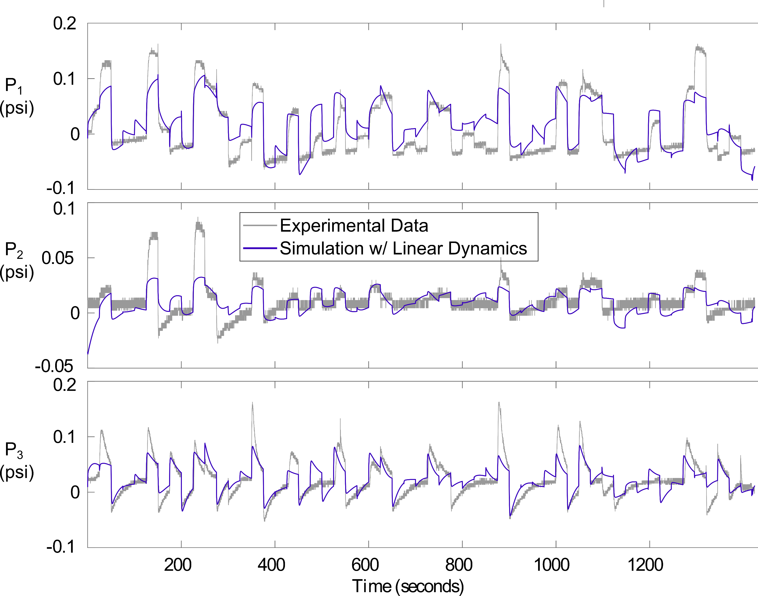
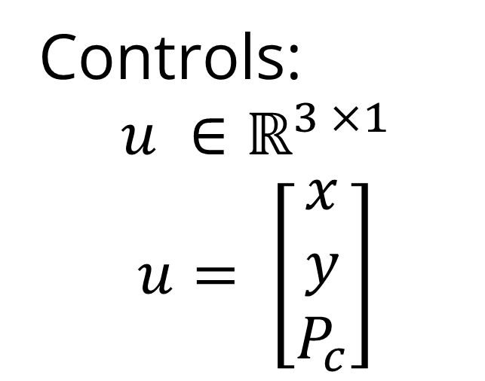
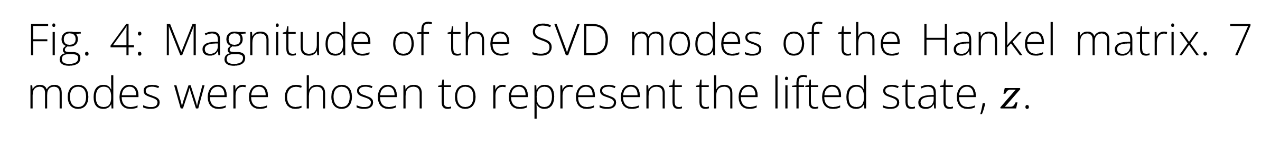
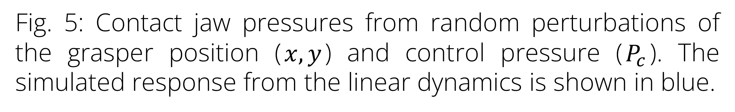
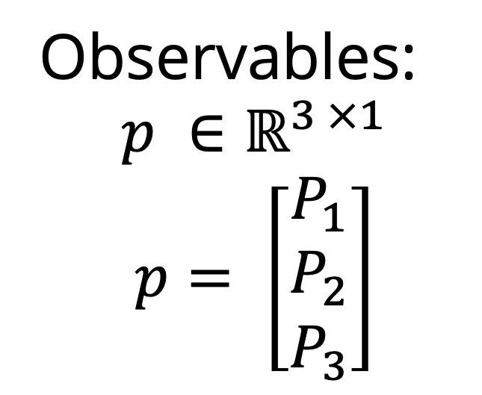
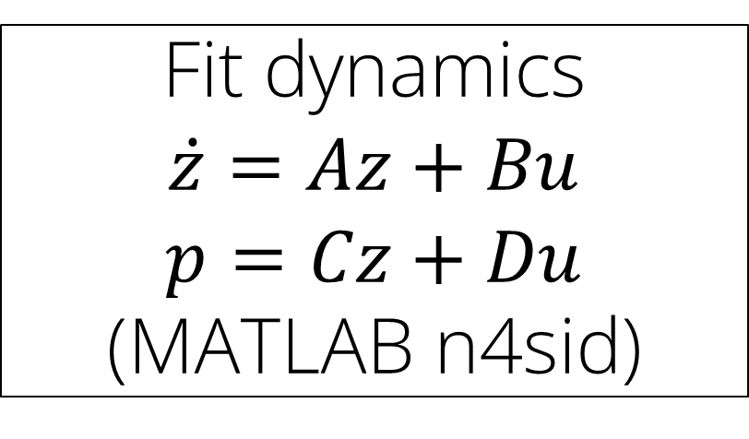

Data-Driven Control of a Soft Bioinspired Grasper
Ravesh Sukhnandan¹, Sreeram Thirupathi², Helen Wang¹, Nathan Zimmerer¹
16-745: Optimal Control and Reinforcement Learning
Carnegie Mellon University: 1) Mechanical Engineering, 2) Robotics Institute
Introduction
Methods
Results
Soft graspers have inherent advantages in handling fragile and deformable objects e.g. fruits, food, biological tissues
However, even very deformable items like soft clays may require active force control to minimize deformation
Observables:
$$p ∈ℝ^{3 ×1}$$
$$p= \left[\begin{matrix}P_{1} \\ P_{2} \\ P_{3}\end{matrix}\right]$$
Random step changes in controls
object
P₁
y
x
y
x
. . .
y
x
A
B
Controls:
$$u ∈ℝ^{3 ×1}$$
$$u= \left[\begin{matrix}x \\ y \\ P_{c}\end{matrix}\right]$$
P₃
P₂
$$P_{c}$$
1
2
N
Fig. 3: Experimental setup to gather data for fitting using random step changes in controls on a fixed cylinder (N = 58).
Results
C
No force control
Undeformed clay cube
Fig. 6: Comparison of desired contact pressures and the simulated response with LQR. The stage cost corresponding to jaw 1’s pressure was given more weight to facilitate closer tracking of that trajectory.
After grasp
Fig. 1: Bio-inspired soft grasper with contact sensing via pneumatic jaws [1]. The grasper decreases the enclosed area when moving from the rest state (A) to the actuated state (B). Without force control, the grasper can impart significant deformations (C).
Future Work
Fig. 4: Magnitude of the SVD modes of the Hankel matrix. 7 modes were chosen to represent the lifted state, $z$.
Further refine the dynamics regression model:
Parse the data and regression such that the dynamics model is fit solely to when the grasper experiences contact
Perform cross validation on tracking error vs quantity of time delays embedded
Cylinders of different sizes
Materials of different rigidity (PLA and soft clay)
Try the LQR controller on hardware and compare the result to the simulation
Quantify deformation induced on deformable material with LQR controller and compare to existing neural-network open-loop controller [1]
Goal: Track arbitrary contact pressure trajectories during grasping of rigid and deformable objects using optimal control techniques
Methods
Soft graspers exhibit behaviors that are hard to analytically model e.g. non-linear material properties, hysteresis, deformable contact etc.
We use a data-driven approach to get the dynamics of the grasper so we can apply optimal control techniques.
Experimental Data
Fit dynamics $$\dot{z}=Az+Bu$$
$$p=Cz+Du$$
(MATLAB n4sid)
NN open-loop
LQR
Work in progress
Design Controller:
LQR
Test controller on hardware
Fig. 5: Contact jaw pressures from random perturbations of the grasper position ($x,y$) and control pressure ($P_{c}$). The simulated response from the linear dynamics is shown in blue.
Fig. 2: Flow chart for controller development
References
[1] R. Sukhnandan et al., LNCS, 2023

